Slide 1
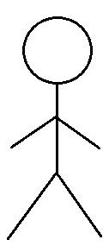
Use Case Diagram
MaidEase
Use Case Diagram
Module: 02. Service Management
2.1 Manage Services
2.2 Add favorite
User
2.3 Book a Service
2.4 Give Ratings/Review
Service Providers
2.5 Modify Appointment
2.6 Send Reminder
Manager

Slide 2
Use Case Diagram
MaidEase
Use Case Diagram
Module: 2.0.5 Modify Appointnment
2.0.1 Create a Account
2.0.2 Log into the Account
2.0.3 Book a Service
User
Service Provider
2.0.5 Can Modify Appointment
2.0.6 Confirm Modification
2.0.7 Provide Services

Slide 3
MaidEase
Use Case Diagram
Module: 2.0.6 Send Remainder
2.0.1 Create a Account
2.0.2 Log into the Account
Subscribed User
2.0.3 Book a Service/Appointment
2.0.4 Receives Remainders

